Slide 1
Accelerated Database Recovery (ADR)
Haripriya Naidu
Lead Database Reliability Engineer
SQL Saturday Boston – October 3rd, 2026
Notes:
Welcome. Today: why SQL Server recovery and rollback can take hours, how Accelerated Database Recovery makes them near-instant, and a live demo at the end.

Slide 2




Haripriya Naidu
Database Reliability Engineer
12 years
Speaker
Blogger
  gohigh.substack.com
  linkedin.com/in/haripriya-naidu1215/
  github.com/haripriyasb/ADR
Notes:
Quick intro. Demo scripts and slides are on GitHub - link at the bottom.

Slide 3
Agenda
Why recovery is slow
What ADR is
How it works
Benefits and results
Live demo
Trade-Offs
Notes:
Six stops: the problem, what ADR is, how it works under the hood, the results, a live demo, and what you need to know to run it in production.

Slide 4
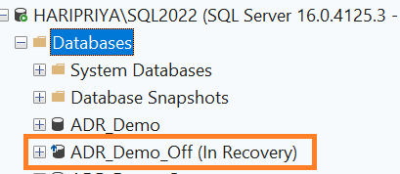
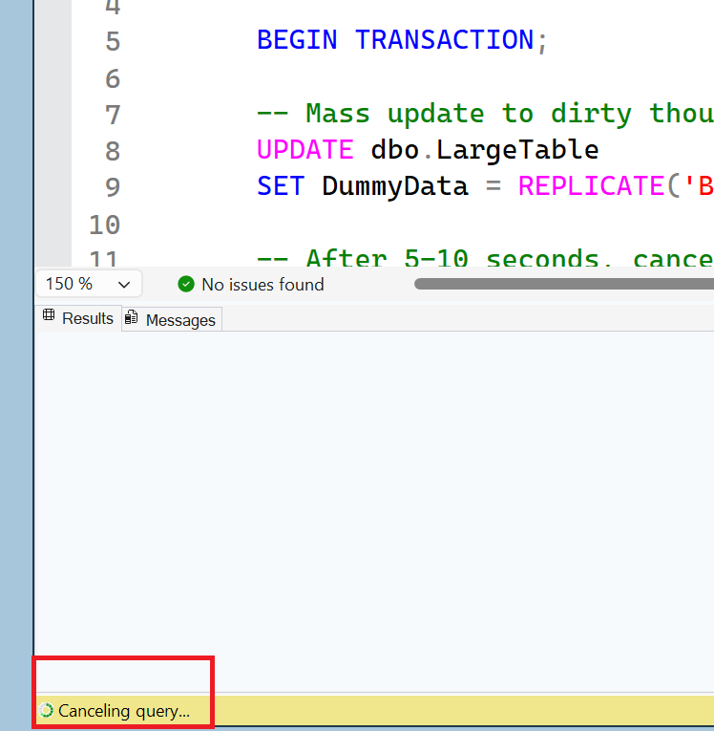
Pain point
Notes:
Who has cancelled a long-running query and then waited even longer for the rollback? Rollback takes about as long as the work itself. Microsoft's own paper describes a customer whose recovery took 12 hours, with the tables locked the entire time. Transition: to see why, let's look at how traditional recovery works.

Slide 5
Traditional Recovery Process
ARIES Model
Phase 1: Analysis
Scans forward from the last checkpoint to identify what belongs to the Redo and Undo processes
Phase 2: Redo
Redo committed operations
Phase 3: Undo
Rollback uncommitted Tx
Log
Start
Oldest uncommitted Tx
Checkpoint
Log End
Data locked by the open transaction stays blocked until UNDO finishes
(Standard edition: the whole DB waits)
Why it's slow: Redo and Undo both reach back to the oldest uncommitted transaction - recovery time grows with your longest transaction, and the log can't be truncated past it.
Notes:
Classic ARIES recovery has three phases. Analysis scans forward from the last checkpoint. Redo replays from the oldest uncommitted transaction. Undo walks the log backward for every transaction that was still open. On Enterprise edition, fast recovery brings the database online after Redo, but anything the open transaction locked stays blocked until Undo finishes; on Standard, the whole database waits. Either way, the cost grows with your longest transaction, and the log can't be truncated past it. Transition: what if rollback didn't need the log at all?

Slide 6
ADR
New database engine feature starting SQL 2019
Available in both Standard and Enterprise editions
Disabled by default in SQL Server
Always enabled in Azure SQL Database, Azure SQL Managed Instance, and SQL database in Fabric
Improves database availability by redesigning the recovery process
Fast and Consistent Database Recovery
Instantaneous Transaction Rollback
Aggressive Log Truncation
Core idea: keep row versions inside the database, so rollback no longer has to walk the log.
Notes:
ADR shipped in SQL Server 2019, Standard and Enterprise. It's off by default on SQL Server and always on in Azure SQL. The core idea fits in one sentence: keep row versions in the database, so rollback no longer has to walk the log. That delivers three things: fast, consistent recovery; instant rollback; and aggressive log truncation.

Slide 7
1. Persistent Version Store - PVS
When DML runs, it persists row versions in the user database itself
Traditional way - version store in the tempdb database.
Row versions are in data pages being modified, or in a separate system table.
Improves availability of readable secondaries in Availability Groups.
Notes:
PVS keeps row versions inside the user database instead of tempdb. Versions are logged, so they survive a crash. Small changes are stored in-row as a diff; larger ones go to an internal off-row table.

Slide 8
Version Store vs Persistent Version Store
 | Version store (tempdb) | Persistent version store (PVS)
Where | tempdb - shared by all databases | Inside each user database
Survives restart? | No - tempdb is recreated at startup | Yes - persisted with the database
Used by | RCSI / snapshot isolation, triggers, online index builds, MARS | ADR - also holds that database's row versions instead of tempdb
Role in recovery | None | Enables instant rollback via logical revert
Notes:
Same idea as the tempdb version store used by RCSI and snapshot isolation - but persistent. With ADR on, that database's row versions go to PVS instead of tempdb.

Slide 9
PVS with Availability Groups
PRIMARY replica
READABLE SECONDARY replica
Data pages
(DML writes here)
Data pages
(redo applies the log)
Transaction log stream
(row versions are logged, so PVS replicates)
PVS - row versions
inside the user database
PVS - same row versions
(arrive via the log)
PVS cleaner
can only remove versions no replica still needs
Read queries
always run as SNAPSHOT isolation and read versions
Low-water mark: oldest version a secondary query still needs
PVS lives inside the database and is replicated through the log - after a failover, the new primary already has the versions ADR needs
A long-running query on a readable secondary holds back PVS (and ghost) cleanup on the primary - PVS can grow
Check low_water_mark_for_ghosts in sys.dm_hadr_database_replica_states; tune or kill long secondary queries
Notes:
Because versions are logged, PVS replicates to secondaries automatically. Secondary queries always run under snapshot isolation. Watch out: a long-running query on a readable secondary holds back PVS cleanup on the primary.

Slide 10
2. Logical Revert
Asynchronous process
Row-level version-based undo
Instant transaction rollback and undo
for all versioned operations.
Keeps track of all aborted transactions
and reverts their versions
Releases all locks immediately after
transaction abort
PVS
Async restore of the last committed version after database is online
Data pages
Short transactions still roll back the traditional way from the log - it takes milliseconds and leaves no aborted versions behind.
Notes:
Rollback becomes 'mark aborted'. Readers skip aborted versions and read the last committed one from PVS. A background task later copies the committed version back to the data page. Locks are released immediately. Small transactions still roll back the classic way from the log, because that takes milliseconds.

Slide 11
3. Secondary Log Stream (SLOG)
Captures non-versioned operations, such as locks and metadata
Built in memory; saved to the transaction log at checkpoints
During recovery, supplies only a few records from before the checkpoint
Transaction log - every operation
SLOG - in memory, non-versioned only
Lock table (X)
Invalidate metadata cache
gray = versioned row changes (millions) purple = non-versioned
Checkpoint: SLOG is written into the transaction log, so it survives a crash
Recovery: for the old part of the log, Redo and Undo read only these few SLOG records
Source: Antonopoulos et al., "Constant Time Recovery in Azure SQL Database", VLDB 2019 (Sec. 3.4)
Notes:
SLOG handles what can't be versioned: locks, cache invalidation, some metadata. It lives in memory and is saved at checkpoints. Example: altering a column on a huge table touches millions of rows but writes only a handful of SLOG records. Microsoft's diagrams spell it sLog - same thing.

Slide 12
4. Cleanup
Reverts aborted rows and removes versions no longer needed
Manual trigger: EXEC sys.sp_persistent_version_cleanup [db_name]
SQL Server 2022+: increase ADR Cleaner Thread Count if cleanup falls behind
Background task - wakes up every few minutes
1. Find pages marked as containing versions (no full database scan)
2. Logically revert rows changed by aborted transactions
3. Remove in-row versions no longer needed
4. Forget those aborted transactions (stop tracking them)
Off-row PVS: whole pages are freed once no snapshot query or aborted transaction needs them
Source: Antonopoulos et al., "Constant Time Recovery in Azure SQL Database", VLDB 2019 (Sec. 3.4, 3.7)
Notes:
The cleaner runs every few minutes. It reverts rows from aborted transactions, then frees versions nobody needs. In SQL Server 2022 it can be multi-threaded. You can also trigger it manually.

Slide 13
Three Kinds of Operations, Three Ways to Recover
Category | Examples | How ADR recovers it
Data modifications | INSERT, UPDATE, DELETE | Row versions in PVS - transaction is marked aborted, Logical Revert cleans up in the background
System operations | Page allocation, B-tree page splits | Short system transactions that commit immediately - unused space reclaimed in the background
Logical / non-versioned | Table-level locks, cache invalidation, boot page | Logged in SLOG - tiny volume, redone/undone almost instantly
Only the last category still needs log-based redo/undo - and it is orders of magnitude smaller than the full transaction log.
Source: Antonopoulos et al., "Constant Time Recovery in Azure SQL Database", VLDB 2019
Notes:
Now that we've seen each piece, here's how they fit together - this is the mental model from Microsoft's paper. Data changes, the bulk of the work, are versioned in PVS. Internal operations like page allocations run in tiny system transactions that commit immediately. Only a small remainder can't be versioned; that goes to SLOG. That's why recovery no longer depends on transaction size.

Slide 14
ADR’s Core Trick - Version Everything
PVS (Persistent Version Store): row versions stored inside the DB, not tempdb
SLOG (Secondary Log Stream): lightweight in-memory stream for non-versioned ops only
Logical revert: undo is asynchronous via PVS, instant from the user's view
Aborted transactions are marked immediately; concurrent queries just ignore their versions
Recovery time becomes CONSTANT - long-running transactions no longer matter
Notes:
One-line recap before we walk through recovery: version the data, log only what can't be versioned, mark failures as aborted, clean up later. (Optional: skip this slide if short on time.)

Slide 15
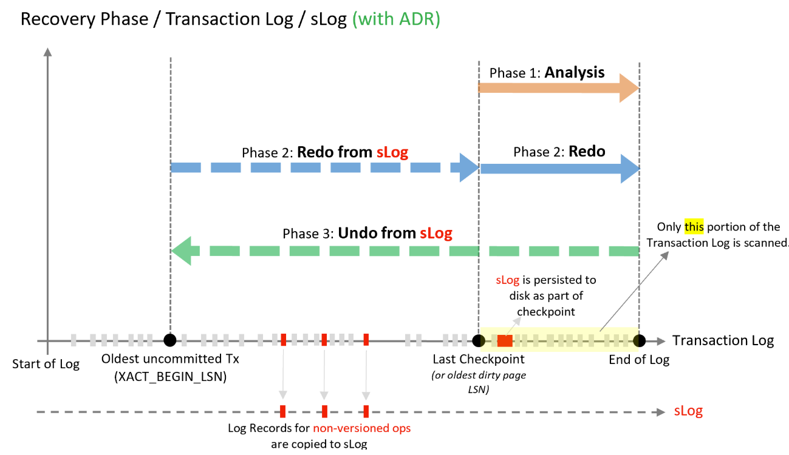
Recovery with ADR
Source: Microsoft Learn - Accelerated Database Recovery concepts
Notes:
Same three phases as before - but each does very different work. Let's take them one at a time.

Slide 16
Phase 1: Analysis — Traditional vs. ADR
T1 starts
Last checkpoint
Crash
Traditional
(ARIES)
Transaction log →
Forward scan from last checkpoint
Determine each transaction's
state: committed vs. active
T1: long-running, uncommitted at crash
Forward scan: checkpoint → end
T1 starts
Last checkpoint
Crash
ADR
Transaction log →
Same forward scan
+ Rebuild SLOG in memory
+ Build Active Transaction Table
T1: long-running, uncommitted at crash
Forward scan: checkpoint → end
+ Rebuild SLOG (non-versioned ops)
Both start at the last checkpoint — ADR additionally rebuilds the SLOG.
Notes:
Analysis starts at the same place in both models: the last checkpoint. ADR additionally rebuilds SLOG and the list of aborted transactions.

Slide 17
Phase 2: Redo — Traditional vs. ADR
T1 starts
Last checkpoint
Crash
Traditional
(ARIES)
Transaction log →
Replays committed work
Scan length grows with the
oldest active transaction
T1: long-running, uncommitted at crash
Forward scan of the FULL log: oldest uncommitted txn → end
T1 starts
Last checkpoint
Crash
ADR
Transaction log →
Subphase 1: SLOG only
(a handful of records)
Subphase 2: log from
last checkpoint only
T1: long-running, uncommitted at crash
Subphase 1: redo from SLOG (non-versioned ops only)
Subphase 2: log from checkpoint
ADR never re-reads the full log back to the oldest active transaction.
Notes:
This is the first big difference. Traditional Redo reads the whole log back to the oldest open transaction. ADR replays only SLOG for that older range, then the log from the checkpoint. Checkpoints are frequent, so this is bounded.

Slide 18
Phase 3: Undo — Traditional vs. ADR
T1 starts
Last checkpoint
Crash
Traditional
(ARIES)
Transaction log →
T1's data stays LOCKED
until undo finishes
(Standard: whole DB waits)
Undo time ∝ size of T1
T1: long-running, uncommitted at crash
Walk the log BACKWARD and undo every operation of T1
T1 starts
Last checkpoint
Crash
ADR
Transaction log →
Database ONLINE immediately
T1's row versions in PVS are
ignored by readers; logical
revert runs in background
T1: long-running, uncommitted at crash
1. Mark T1 ABORTED (instant)
No backward scan of T1's log records
2. Undo non-versioned ops via SLOG
Near-instant: the database comes online without physically rolling T1 back first.
Notes:
Second big difference. Traditional Undo walks backward through every operation of T1 - its rows stay locked the whole time, and on Standard edition the entire database waits. ADR marks T1 aborted, undoes the few SLOG records, and everything is available.

Slide 19
After Recovery: Background Cleanup
Database online
Logical revert
PVS cleaner
Log truncation
Undo phase finished
No waiting on T1's size
Queries skip aborted versions
Async, after online
Row-level undo using PVS:
restores last committed version
Locks already released
Async, periodic
Removes aborted / obsolete
row versions from PVS
SQL 2022+: multi-threaded
Long transactions no longer
hold the log
(except with replication / CDC)
Expensive cleanup moves off the critical path — the database is already online.
Notes:
The expensive work hasn't disappeared - it's moved off the critical path. Logical revert and the PVS cleaner run in the background while users are already working.

Slide 20
Components of ADR
Problem in traditional recovery | ADR component that solves it
Undo walks the log backward, row by row | PVS keeps earlier row versions; Logical Revert restores them
Some operations can't be versioned (locks, metadata) | SLOG - a small, in-memory log just for those
Redo reads back to the oldest open transaction | SLOG covers that range; the full log is replayed only from the checkpoint
Old row versions pile up | Cleaner removes them in the background
Notes:
Each ADR component answers one problem from the traditional recovery slide. PVS and Logical Revert replace the backward log walk. SLOG handles the few things that can't be versioned and lets Redo skip the old part of the log. The Cleaner keeps versions from piling up. Let's take them one at a time.

Slide 21
Results from Production and Lab
Recovery time - 3M+ Azure SQL databases (May 2019)
Lab: one transaction touching 50M rows (200-byte rows)
Percentile | Without ADR | With ADR
99.9% | 68 sec | 60 sec
99.99% | > 10 min | 1.3 min
99.999% | > 1 hour | 3 min
Operation | Log w/o ADR | Log with ADR | PVS
Inserts | 25,873 MB | 185 MB | 0 MB
Updates | 15,680 MB | 78 MB | 908 MB
Deletes | 38,255 MB | 147 MB | 0 MB
Typical recovery barely changes - ADR eliminates the rare hour-long outliers
Log stays small and is truncated continuously, even during a 50M-row transaction
Inserts and deletes add no PVS space; updates store only the diff in-row
Source: Antonopoulos et al., "Constant Time Recovery in Azure SQL Database", VLDB 2019
Notes:
Real numbers from Microsoft. Across three million Azure SQL databases, typical recovery barely changed, but the worst cases went from more than an hour to three minutes. In the lab, a 50-million-row transaction needed tens of GB of log without ADR and under 200 MB with it.

Slide 22
Aggressive Log Truncation
Versioned operations are stored in PVS
Non-versioned operations are stored in SLOG
Log doesn't need to be retained for UNDO
Log truncates at checkpoints and backups - even with long-running transactions open
Notes:
Because undo no longer needs the log, it can be truncated at checkpoints and backups even with a long transaction open. Exception: transactional replication and CDC still hold the log for the log reader.

Slide 23
Workloads that benefit from ADR
Long-running transactions
Active transactions that cause the transaction log to grow significantly
Long periods of database unavailability due to long-running recovery (unexpected restart or manual rollback)
Less ideal: very high volume of single-row DML transactions - batch them where possible
Overhead measured by Microsoft (vs. tempdb versioning): ~2.4% throughput for a typical OLTP mix, ~13.8% for an extremely update-heavy one
Notes:
Biggest wins: long transactions, big rollbacks, runaway logs. The cost: Microsoft measured about 2 percent throughput overhead for a typical OLTP mix and about 14 percent for an extremely update-heavy one, compared with tempdb versioning.

Slide 24
Enable ADR
Requires an exclusive database lock - add WITH ROLLBACK IMMEDIATE to end active sessions
ALTER DATABASE ADR_Demo_On SET ACCELERATED_DATABASE_RECOVERY = ON;
SELECT
name,
is_accelerated_database_recovery_on
FROM sys.databases;
-- Optional: dedicated PVS filegroup (to move an existing PVS, disable ADR and clean up first)
ALTER DATABASE ADR_Demo_On SET ACCELERATED_DATABASE_RECOVERY = ON
(PERSISTENT_VERSION_STORE_FILEGROUP = [VersionStoreFG]);
Notes:
One ALTER DATABASE statement, but it needs an exclusive lock - use WITH ROLLBACK IMMEDIATE in a maintenance window. Optionally put PVS on its own filegroup. If you disable ADR later, existing versions remain until active transactions finish, and optimized locking must be turned off first. Transition: let's see it.

Slide 25
DEMO
Notes:
Demo: run the same large transaction in ADR_Demo_Off and ADR_Demo_On, cancel it, and compare rollback time. Then show PVS size in the DMV. Fallback: recorded video if the live demo fails.

Slide 26
What's New in SQL Server 2022 and 2025
SQL Server 2022
SQL Server 2025
Multi-threaded PVS cleanup (ADR Cleaner Thread Count)
Transaction-level PVS: committed versions cleaned up even while aborted ones remain
Smaller memory footprint for PVS page tracking
User transactions help clean pages the cleaner could not lock
Cleanup failures in error log + tx_mtvc2_sweep_stats XE
Optimized locking (TID locking + lock after qualification) - requires ADR on the database
Source: Microsoft Learn - Accelerated database recovery concepts; Optimized locking
Notes:
SQL Server 2022 focused on making PVS cleanup faster and more robust. SQL Server 2025 brings ADR to tempdb and adds optimized locking, which requires ADR - another reason to enable it.

Slide 27
Best Practices for ADR
Leave free space in the database for PVS - if PVS can't grow, DML statements fail
Avoid unnecessary long-running transactions - they delay PVS cleanup
Avoid large transactions with many DDL operations - they bloat the SLOG
Reduce aborted transactions (deadlocks, timeouts, constraint violations) - they pressure the cleaner
Replication / CDC: aggressive log truncation is disabled - size the transaction log accordingly
SQL Server 2022+: increase ADR Cleaner Thread Count if cleanup can't keep up
Notes:
Most of these come down to: give PVS room, and keep the cleaner unblocked. Avoid unnecessarily long transactions, huge DDL transactions, and high abort rates.

Slide 28
Monitoring: What to Watch
sys.dm_tran_persistent_version_store_stats - PVS size, cleaner start/end times, oldest active and aborted transaction
PVS is "large" if it is near 50% of the database size or far above your baseline
SQL Server 2022+: tx_mtvc2_sweep_stats extended event; cleanup failures logged in the error log
Why it matters: Microsoft's main production issue was cleanup blocked by user transactions - PVS grew until disk ran out
Notes:
One DMV tells you most of what you need. Baseline PVS size during normal activity, and alert when it approaches 50 percent of the database or grows well past your baseline.

Slide 29
Troubleshooting a Large PVS
Cause | Check | Fix
Long-running active transactions | sys.dm_tran_database_transactions (oldest begin time) | Commit, roll back, or kill the session
Long RCSI / snapshot scans | sys.dm_tran_active_snapshot_database_transactions | Tune the query, or use READ COMMITTED for long reports
Long queries on readable secondaries | low_water_mark_for_ghosts in sys.dm_hadr_database_replica_states | Find and end the query on the secondary
Many aborted transactions | sys.dm_tran_aborted_transactions | Reduce deadlocks / timeouts; SQL 2022+: raise ADR Cleaner Thread Count
Force cleanup between workloads: EXEC sys.sp_persistent_version_cleanup [db_name]
Source: Microsoft Learn - Monitor and troubleshoot accelerated database recovery
Notes:
Four common causes, each with a DMV to confirm it. Fix the cause first; use the manual cleanup procedure between workloads.

Slide 30
Watch out!
ADR in tempdb is new in SQL Server 2025 - test before enabling in production
Known issue: creating and dropping (or truncating) temp tables at a high rate can cause latch contention on sys.sysseobjvalues - fix planned for a later release
Enabling or disabling ADR in tempdb requires a SQL Server restart
ADR isn't supported with database mirroring
Notes:
ADR in tempdb is new in 2025. Microsoft documents a known latch-contention issue when temp tables are created and dropped at a high rate - test before enabling. It also needs a restart.

Slide 31
Takeaways
Traditional recovery time grows with your longest-running transaction
ADR versions row changes in PVS and logs only non-versioned operations in SLOG
Recovery reads the log only from the last checkpoint - undo is near-instant
Rollback is instant, and the log can truncate even with long transactions open
Enable it on SQL Server 2019+, then monitor PVS size and cleanup
SQL Server 2025: optimized locking requires ADR - one more reason to turn it on
Notes:
If you remember one thing: with ADR, recovery and rollback time no longer depend on the size of your transactions.

Slide 32
Resources
https://learn.microsoft.com/en-us/sql/relational-databases/accelerated-database-recovery-concepts?view=sql-server-ver17
https://learn.microsoft.com/en-us/sql/relational-databases/accelerated-database-recovery-troubleshoot?view=sql-server-ver17&tabs=sql-server-sql-mi
https://www.microsoft.com/en-us/research/publication/constant-time-recovery-in-azure-sql-database/
https://www.youtube.com/watch?v=ro-iryiNkrg
Notes:
Microsoft Learn docs, the troubleshooting guide, and the Constant Time Recovery paper from VLDB 2019.

Slide 33
Thank you!
gohigh.substack.com
linkedin.com/in/haripriya-naidu1215/
github.com/haripriyasb/ADR
Notes:
Thank attendees and sponsors; share the feedback link.

